Slide 1

AI for Generating Game Levels
CAP 4630 – Intro to Artificial Intelligence Team 25 – Tye Kates, Rodney Benjamin, Thomas Gregory, Jacob Eurglunes, Adam Kieszkowski

Slide 2
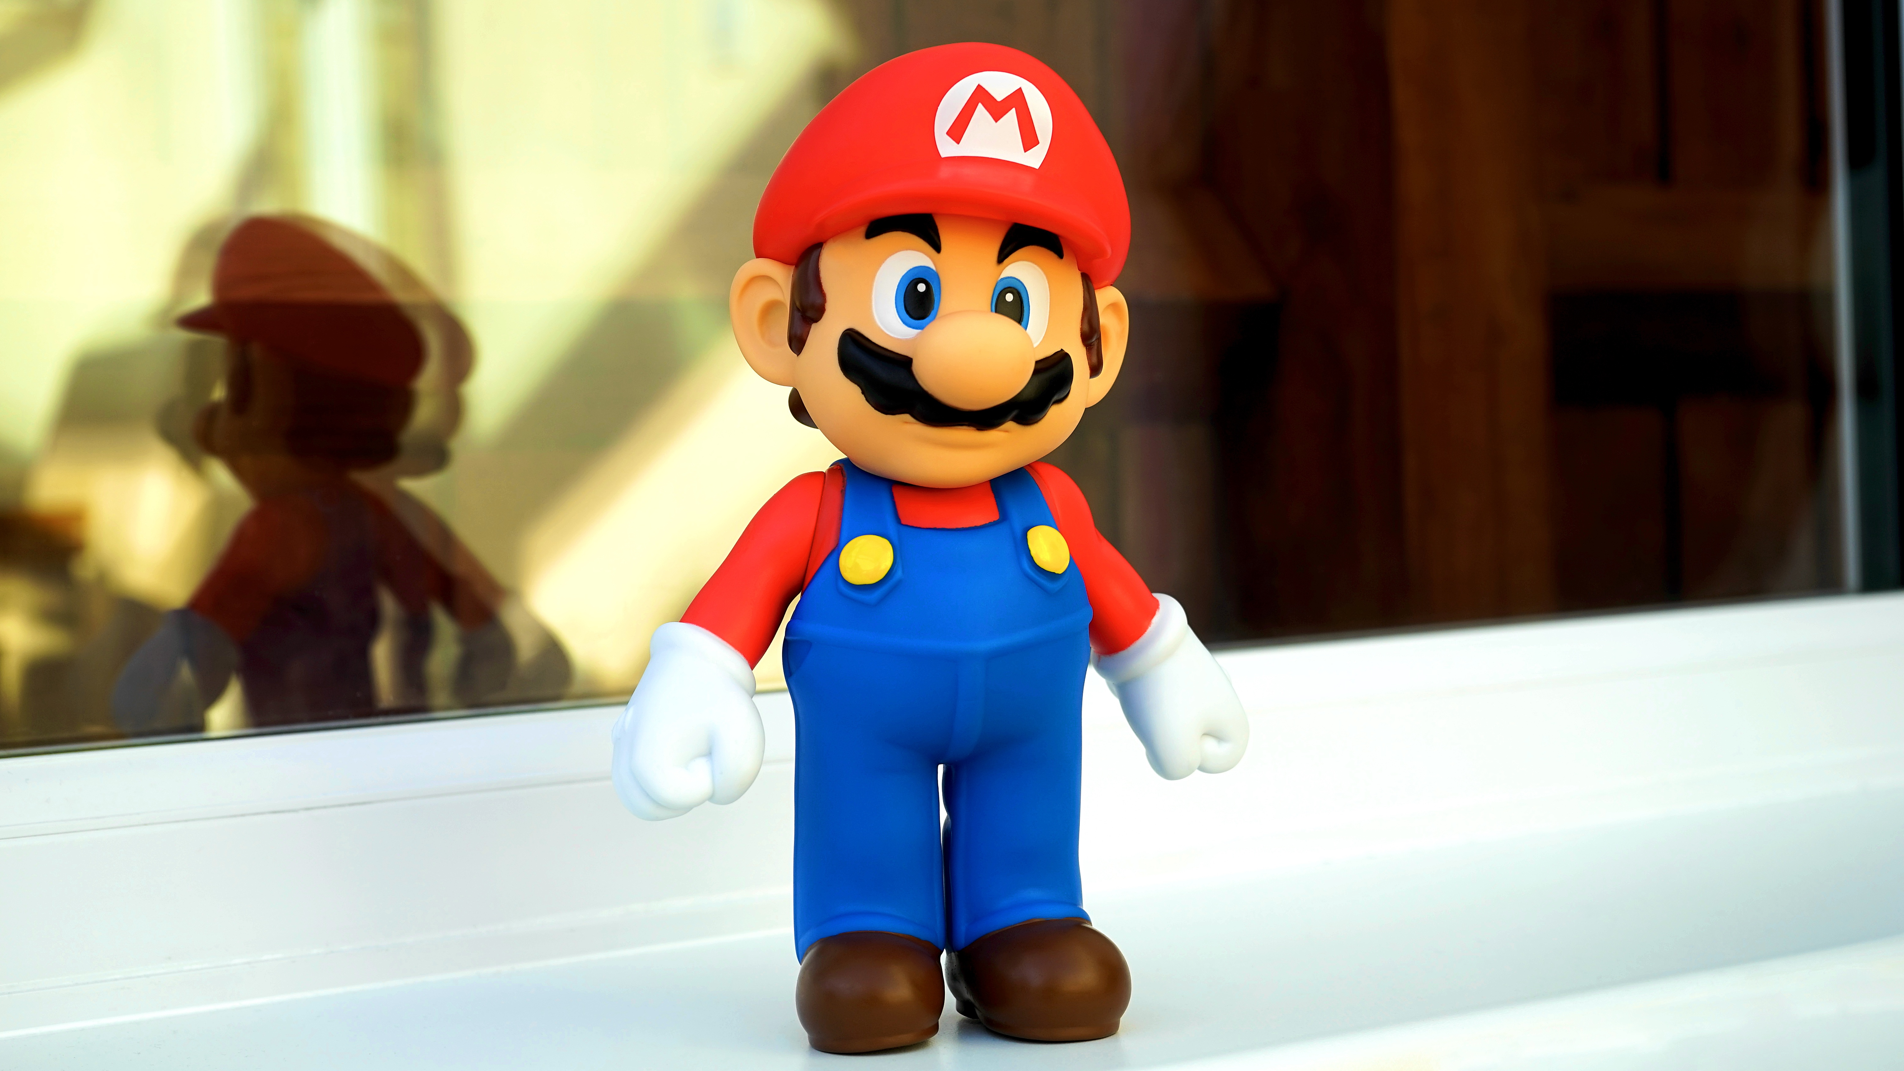
Objectives
Use AI to generate new 2D, tile-based platformer levels from text.
Compare a simple 3-gram (Markov) baseline with an LSTM model.
Evaluate how similar the generated levels are to the originals and if they pass simple playability rules.

Slide 3
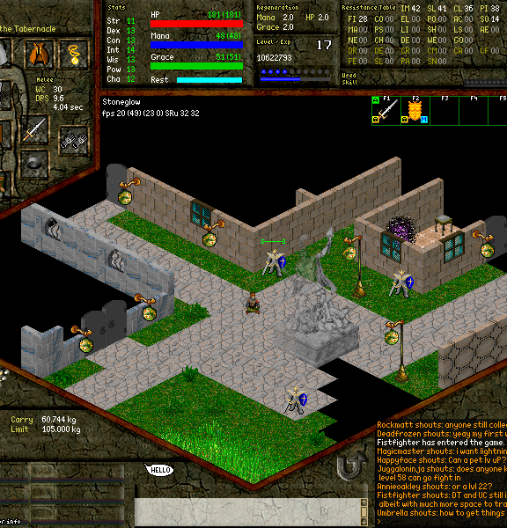
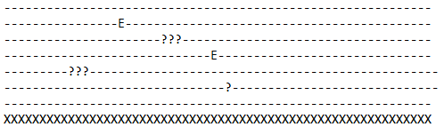
Dataset: ASCII Tile Levels
Example training level snippet:
Manually created a small set of 2D levels as plain text.
Each level uses a small tile vocabulary:
X = ground
- = empty space
? = question block
E = enemy
Levels are stored line by line with a fixed width per row.
This Photo by Unknown Author is licensed under CC BY-SA

Slide 4

Models
3-gram (Markov) baseline
Predicts each next character based on the previous 2 characters.
Very simple and fast.
Captures short-range patterns (like "XX" or "??"), but not long-range structure.
LSTM (character-level RNN)
Reads sequences of characters and learns longer-range patterns.
Better at modeling global structure of levels.
Trained at character level on the same text corpus as the 3-gram.
This Photo by Unknown Author is licensed under CC BY-SA

Slide 5
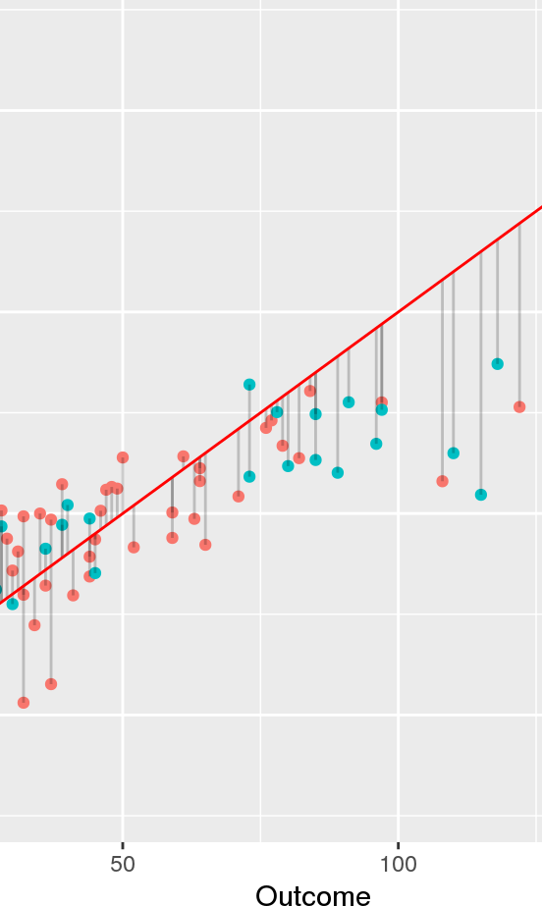
Methodology / Pipeline
Data preparation
Combine all level text files into a single corpus (dataset.txt).
Keep rows at a fixed width and restrict to the tile set {X, -, ?, E}.
Model training
Train the 3-gram model on the corpus.
Train the LSTM for multiple epochs on the same data.
Generation
Use each model to generate a long sequence of tiles.
Reshape the text into level-like rows.
Evaluation
Compare tile statistics to the original data.
Apply simple playability rules (fixed width, allowed tiles).
This Photo by Unknown Author is licensed under CC BY-SA-NC

Slide 6
Training Details
Metric | Value
Corpus Size | 4,907 characters
LSTM Epoch 1 Loss | 0.3532
LSTM Epoch 2 Loss | 0.1840
LSTM Epoch 3 Loss | 0.1700
3-gram Training Time | Instant (count-based model)

Slide 7
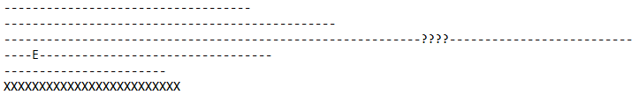
Qualitative Results: Original vs 3-gram vs LSTM
Original level snippet:
Original: clean, consistent width, structured platforms.
3-gram model sample:
3-gram: noisy and repetitive,
weak global structure.
LSTM model sample:
LSTM: more coherent segments, but still some structural issues.

Slide 8

Quantitative Results
Style similarity (3-gram KL divergence):
KL ≈ 0.0513 between the LSTM sample and the training distribution.
Very close to the original distribution (lower is better).
Playability rule check:
Rule: all rows must have the same width and use only allowed tiles.
Result for the shown LSTM level:
playable = False
reason = "inconsistent width“
Interpretation:
The LSTM successfully matched the tile frequency distribution of the training levels.
However, structural issues like uneven line length still prevent full playability.

Slide 9

Challenges & Limitations
Small, hand-made dataset (limited variety of levels).
3-gram baseline:
Often produces noisy, repetitive patterns.
Fails to maintain coherent level structure.
LSTM:
Sometimes generates lines that are too long or inconsistent in width.
No hard constraints to guarantee full playability.
Limited time for hyperparameter tuning and more advanced models.

Slide 10

Conclusion & Future Work
Conclusion:
Both models learned aspects of the training levels.
The LSTM produced more coherent, game-like layouts than the 3-gram baseline.
A simple rule-based check revealed structural issues like inconsistent width.
Future Work:
Add post-processing or constraints to enforce fixed row width.
Train on a larger and more diverse level dataset.
Explore more advanced sequence models (e.g., Transformers).
Incorporate playability constraints or a reward signal when generating.
This Photo by Unknown Author is licensed under CC BY

Slide 11
Code, Demo, and Repository
Code repository (GitHub):
Includes src/, data/, models/, reports/, and README.md.
Demo video:
Screen recording of the Colab notebook:
Running training.
Generating levels with 3-gram and LSTM.
Showing sample outputs.
Team:
Tye Kates, Rodney Benjamin, Thomas Gregory, Jacob Eurglunes, Adam Kieszkowski

